Slide 1
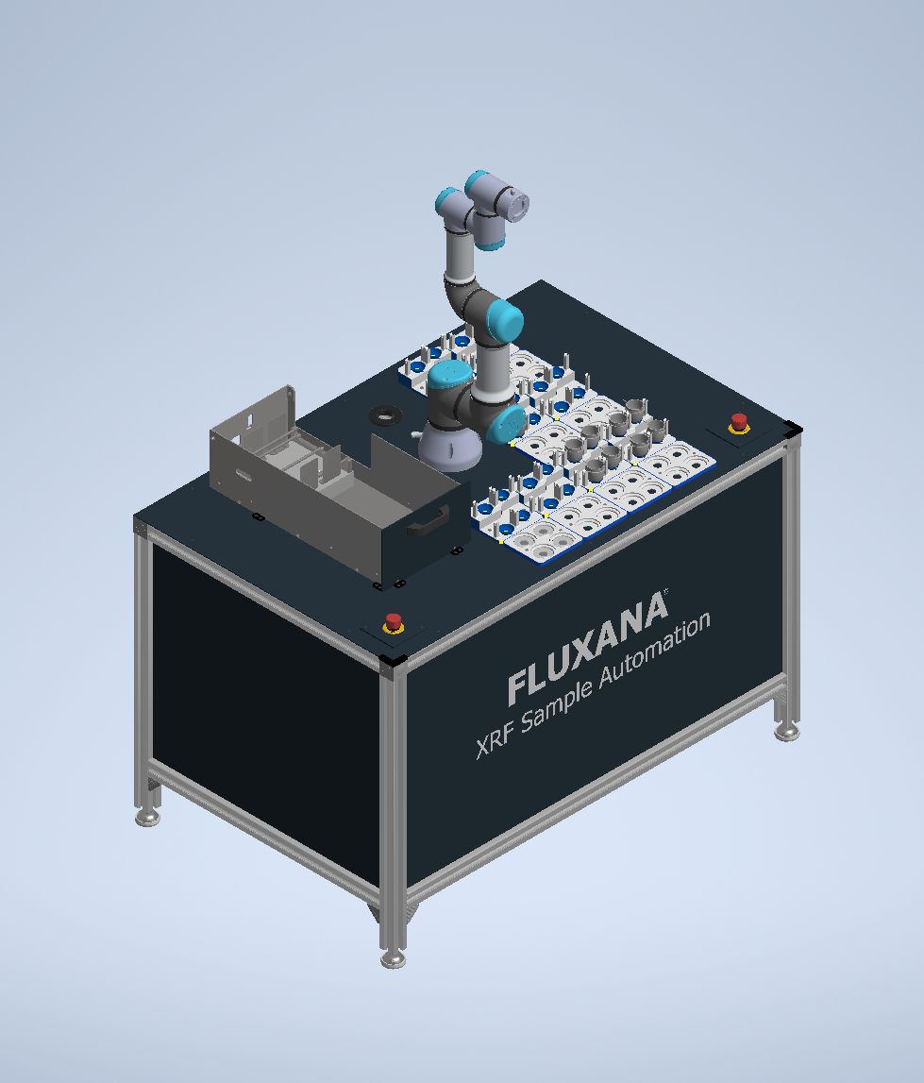
Cobot Project Timeline
Carine Allen

Slide 2
1
Farah Kamal Bachelor’s Thesis (3 months)
Description
Learning Objectives
The thesis will present how to use ROS (Robotic Operating System) and Moveit (Motion Planning Framework) to control a industrial robot, in this case, a universal robots model UR3e.
It will explain the main concepts of ROS and Moveit and, with a custom made Fluxana library, it will show the execution of basic robot commands thought a GUI made with Python.
These basic commands can include:
Initialize the robot
Move robot joints to a desirable point
Move robot to a pre-established home location
Open and close gripper
Acquired knowledge about ROS and Moveit and how to implement them with a industrial robot.
Creation a custom made Fluxana library for industrial robots controlling.
Establishment of the communication structure between a GUI in a Fluxana machine computer and the robot.
Set up of a Fluxana cobot internal network.

Slide 3
2
1st Internship – March 2023 (6 months)
Description
Desirable prerequisites
The Internship will consist of the implementation of the Niryo Ned2 robot with the Fluxana library to perform a powder dosage task. By utilizing ROS (Robotic Operating System) and Moveit (Motion Planning Framework) that are integrated in the Fluxana cobot library.
Basic Linux: navigation of Linux filesystem; creation of files; how to manipulate and edit a file, execution and permissions of files.
Object-Oriented Programming: Python is preferred.
GUI: It’s good to know how to make programs with a user interface (Python-Tkinter is preferred)
Basic Physics & Math knowledge: kinematics, Probability, linear algebra and analytic geometry.
Basic electronics: Electronic Components, digital logic, motors (e.g. stepper motors) and sensors.
Learning Objectives
Acquired knowledge about how to integrate Niryo Ned2 with ROS and Moveit.
Expansion of Fluxana library functions to comport Niryo Ned2 robot.
Performance & validation of a powder dosage task.

Slide 4
3
2nd Internship – September 2023 (6 months)
Description
Desirable prerequisites
The Internship will consist of creating a pick and place crucible task for a Universal robot UR3e using the Fluxana cobot library with custom frames and transforms.
Basic Linux: navigation of Linux filesystem; creation of files; how to manipulate and edit a file, execution and permissions of files.
Object-Oriented Programming: Python is preferred.
GUI: It’s good to know how to make programs with a user interface (Python-Tkinter is preferred)
Basic Physics & Math knowledge: kinematics, Probability, linear algebra and analytic geometry.
CAD: 3D modelling (Autodesk Inventor is preferred).
Learning Objectives
Acquired knowledge about how add physical properties to a URDF Model (Collision, Frictions…).
Integration of Fluxana’s components (table, drawer, crucible holders, pallets) as custom frames in Moveit through XACRO and URDF files.
Performance & validation of a pick and place crucible task.

